Slide 1
What’s new in Java 8 Indroduction
Pregatit de: Radu Sezciuc Data: 23.06.2016

Slide 2
What are we going to cover? ● Lambda Expressions ● Streams ● Collectors
Pregatit de: Radu Sezciuc Data: 23.06.2016

Slide 3
Why Java 8?
• We write obscure code to do simple things:
Collections.sort(inventory,new Comparator<Apple>() {
public int compare(Apple a1, Apple a2){
return a1.getWeight().compareTo(a2.getWeight());
});

Slide 4
Why Java 8?
Collections.sort(inventory,new Comparator<Apple>() {
public int compare(Apple a1, Apple a2){
return a1.getWeight().compareTo(a2.getWeight());
});
vs
inventory.sort(comparing(Apple::getWeight));

Slide 5
Why Java 8?
• Introduces a concise way to pass behavior
– lambda expressions, method references
• Introduces an API to process data in parallel
– Streams API
– several operations such as filter, map, reduce can be parameterised with lambdas
• Also: default methods
– more flexible inheritance

Slide 6
Behaviour parameterisation
• Goal: abstract over behaviour
– Do <something> for every element in a list
– Do <something> else when the list is finished
– Do <yet something else> if an error occurs
• Why should you care?
– Adapt to changing requirements
– Java 8 Streams API heavily relies on it

Slide 7
1st attempt: filtering green apples
List<Apple> filterGreenApples(List<Apple> inventory) {
List<Apple> result = new ArrayList<>();
for(Apple apple: inventory){
if("green".equals(apple.getColor() ) {
result.add(apple);
}
}
return result;
}

Slide 8
2nd attempt: abstracting color
public static List<Apple>
filterApplesByColour(List<Apple> inventory, String color) {
List<Apple> result = new ArrayList<>();
for (Apple apple: inventory){
if (apple.getColor().equals(color))) {
result.add(apple); }
}
return result;
}
}

Slide 9
3d attempt: abstracting weight
filterApplesByWeight(List<Apple> inventory, int weight) {
List<Apple> result = new ArrayList<>();
for (Apple apple: inventory){
if (apple.getWeight() > weight) {
result.add(apple); }
}
return result;
}

Slide 10
4th (a) attempt: modeling selection criteria
public interface ApplePredicate {
public boolean test (Apple apple);
}
public class AppleWeightPredicate implements ApplePredicate {
public boolean test(Apple apple){
return apple.getWeight() > 150;
}
}
public class AppleColorPredicate implements ApplePredicate {
public boolean test(Apple apple){
return "green".equals(apple.getColor());
}
}

Slide 11
Let’s pause for a little bit
Our code is much more flexible!
– can create any kinds of selection criteria on an Apple
– re-use of code for filter
• Declaring many selection criteria using classes is verbose
– we have the right abstraction but not good concision
– we need a better way to create and pass behaviour

Slide 12
5th attempt: anonymous classes
List<Apple> result = filter(inventory, new ApplePredicate() {
public boolean test(Apple apple){
return "red".equals.(apple.getColor());
}
});
List<Apple> result = filter(inventory, new ApplePredicate() {
public boolean test(Apple apple){
return apple.getWeight() > 150;
}
});

Slide 13
Exercise (1)
You are to write a prettyPrintApple method that takes a List of Apples and that can be parameterized with multiple ways to generate a String output from an Apple (a bit like multiple customized toString methods).
For example, you could tell your prettyPrintApple method to print only all the weight of the apples In addition, you could to tell your prettyPrintApple method to print each apple individually and mention whether they are “heavy” or “light”.
com.java_8_training.problems.lambdas.BehaviourParameterisation

Slide 14
Exercise (2)
Towards prettyPrint...
Implement the method prettyPrintOnlyWeightApple (List<Apple> inventory): it should just print the weight of each apple iteratively.
2. Can you abstract the formatting algorithm? (i.e. how to generate a string from an apple)
3. Gradually work towards a method prettyPrintApple which takes a list of apples and an formatter operation to execute on each apple
4. Can you make it generic? (not only apples, but any type?)

Slide 15
6th attempt: Java 8 lambdas
List<Apple> result =
filter(inventory,
(Apple apple) -> "red".equals(apple.getColor()));
List<Apple> result =
filter(inventory, (Apple apple) -> apple.getWeight() > 150);
Great because it reads closer to the problem statement!

Slide 16
7th attempt: abstracting over the list type
public static <T> List<T> filter (List<T> list, Predicate<T> p) {
List<T> result = new ArrayList<>();
for(T e: list){
if(p.test(e)) {
result.add(e);
}
}
return result;
}

Slide 17
8th attempt: Java 8 lambdas again
List<String> result = filter(strings, (String s) -> s.endsWith("JDK"));
List<Integer> result = filter(numbers, (Integer i) -> i % 2 == 0);
List<Apple> result =filter(inventory, (Apple a) -> apple.getWeight() >150);

Slide 18
Moral of the story
Behaviour parameterisation lets you write more flexible code:
– Adapt for changes
– Avoids code duplication
To encourage this style of programming we need a concise way to create and pass behaviours:
– Java 8 brings lambda expressions to help!

Slide 19
What is a Lambda Expression?
– a kind of anonymous function
-> Anonymous: doesn’t have a name like a method: less to write and think about!
-> Function: not associated to a class like a method is
– that can be passed around:
->A lambda expression can be passed as argument to a method or stored in a variable
– It doesn’t have a name, but it has a list of parameters, a body, a return type, and also possibly a list of exceptions that can be thrown.

Slide 20
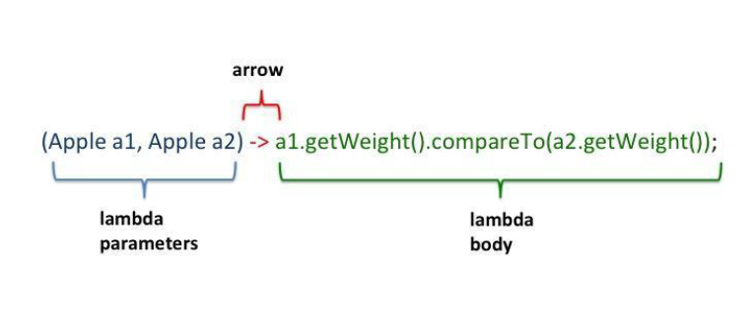
Lambda Expressions: what is it?

Slide 21
Goal
Goal: let you pass a piece of behaviour/code in a concise way
• You can cope with changing requirements by using a behaviour, represented by a lambda, as a parameter to a method
• You no longer need to choose between abstraction and concision!

Slide 22
Before/After
Before:
inventory.sort(new Comparator<Apple>() {
public int compare(Apple a1, Apple a2){
return a1.getWeight().compareTo(a2.getWeight());
}
});
After:
inventory.sort((Apple a1, Apple a2) -> a1.getWeight().compareTo(a2.getWeight()));

Slide 23
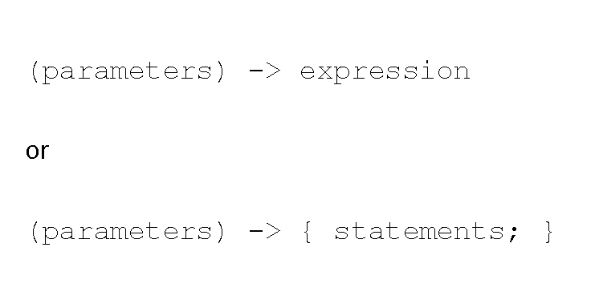
Syntax

Slide 24
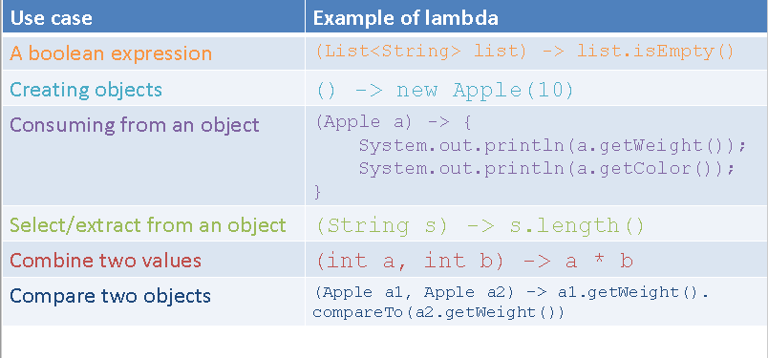
Examples

Slide 25
Quiz: which are not valid?
1. () -> {}
2. () -> "Raoul"
3. () -> {return "Richard";}
4. (Integer i) -> return "James" + i;
5. (String s) -> {"Raoul";}
Daca vrei sa scrii return trebuie sa pui acolade.

Slide 26
Three Question About Lambdas
1. What is the type of a lambda expression?
2. Can a lambda be put in a variable?
3. Is a lambda expression an object?

Slide 27
. What is the type of a lambda expression?
A functional interface - an interface with only one abstract method
public interface Comparator<T>{
int compare(T t1, T t2);
}
}

Slide 28
Can a lambda be put in a variable?
YES
Comparator<String> c = (String s1, String s2) ->
Integer.compare(s1.length(), s2.length());

Slide 29
Is a lambda expression an object?
Let’s compare the following :
Comparator<String> c = (String s1, String s2) ->
Integer.compare(s1.length(), s2.length());
Comparator<String>c =
new Comparator<String>(String s1, String s2){
public Boolean compareTo(String s1, String s2){
Integer.compare(s1.length(), s2.length());
}
}

Slide 30
More about the sintax
Let’s compare the following :
Comparator<String> c = (String s1, String s2) ->
Integer.compare(s1.length(), s2.length());
Comparator<String> c = (s1, s2) ->
Integer.compare(s1.length(), s2.length());

Slide 31
Exercise
Refactor the code to use lambda expressions and
standard functional interfaces from java.util.function.*
com.java_8_training.problems.lambdas.LambdaRefactorTest

Slide 32
Method references
Before: (Apple a) -> a.getWeight().
After: Apple::getWeight
Before: (String str, int i) -> str.substring(i)
After: String::substring

Slide 33
Method references: example
List<String> str = Arrays.asList("a","b","A","B");
Before
str.sort((String s1, String s2)
-> s1.compareToIgnoreCase(s2));
After
str.sort(String::compareToIgnoreCase);

Slide 34
So What Do We Have so Far?
A new concept : the <<lambda expression>>, with a new syntax.
A new interface concept : the <<functional interface >>
Question : How can we use this to process data?

Slide 35
Exercise: method references
What are equivalent method references for the following lambda expressions?
com.java_8_training.problems.lambdas.MethodRefsQuizTest

Slide 36
Questions?

Slide 37
Thank you!

